Slide 1
Patron Blocks - Librarian assigned and system assigned
Yoel Kortick
Senior Librarian

Slide 2

Agenda
Introduction – Types of Blocks
Librarian-assigned Blocks
Table "User Block Descriptions"
Table "User Block Definitions"
Tables summary – librarian assigned blocks
Testing the librarian-assigned blocks
System-assigned blocks
System-assigned Loan Limits
System-assigned Patron Limits
Testing System-assigned Loan & Patron Limits
Overriding the system-assigned blocks

Slide 3
Introduction

Slide 4
Introduction – Types of Blocks
There are two types of "blocks" which may exist when a patron tries to loan, renew or make a hold request:
"Librarian-assigned"
Defined by librarian and manually assigned to the patron via the "blocks" section of the user record
"System-assigned" automatically based on pre-defined configuration
Resulting from the patron having reached defined limit of loans, hold requests, or owed cash

Slide 5
Introduction – Types of Blocks
The "Librarian-assigned" blocks are typically defined at the time of implementation and rarely if at all change at a later stage
The "System-assigned" blocks are accessible via configuration menus to staff who have completed certification training and have role "Fulfillment Administrator".
These are also known as "limits" and the "block" occurs when the "limit" is surpassed

Slide 6
Introduction – Types of Blocks
This presentation will define, explain and provide examples of each type of block.
We will begin with "Librarian-assigned" blocks
We will then move to "System-assigned" blocks
See also:
Configuring Loan Limit Rules
Configuring User Block Descriptions and Definitions

Slide 7
Librarian-assigned blocks

Slide 8
Librarian-assigned blocks
It is possible to define in the "blocks" section of the user that he or she will be blocked from making loans, renewals or hold requests.
Each block may contain one or a combination of these blocks, together with a specific reason for the block.

Slide 9
Table "User Block Descriptions"

Slide 10
Table "User Block Descriptions"
This table defines the codes and corresponding descriptions of the blocks which will later be used in the configuration to block loans, renewals and hold requests.
The table is accessed at "Configuration Menu > Fulfillment > Patron Configurations > User Block Descriptions".

Slide 11
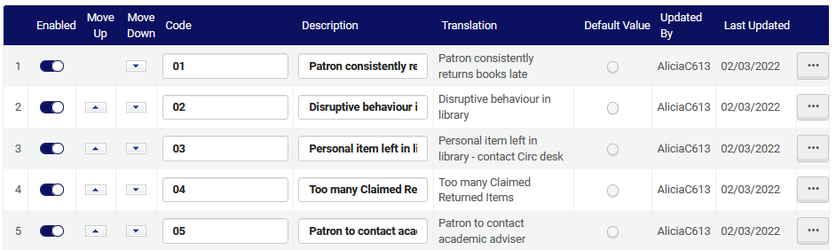
Table "User Block Descriptions"
Here we have defined some different reasons why the user may be blocked. (This is just the beginning of the table)
Later we will "connect" them to specific blocks

Slide 12
Table "User Block Definitions"

Slide 13
Table "User Block Definitions"
We will now define the actual user block definitions
The table is accessed at "Configuration Menu > Fulfillment > Patron Configurations > User Block Definitions".
As described at Adding User Block Definitions, there are three types of blocked actions used in the "User Block Definitions":
01 – loan
02 – loan, renew
03 – loan, renew, hold

Slide 14
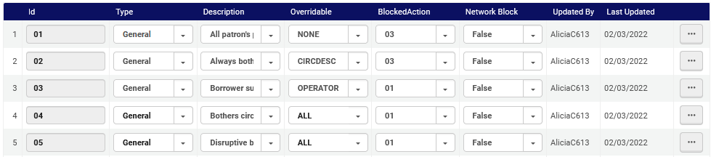
Table "User Block Definitions"
When creating a new mapping row for "User Block Definitions" …
The Type value is for information only and does not impact the system, with the exception of the Demerit and Consortial Block type, whose values should not be changed.
These are the descriptions we defined in Table "User Block Descriptions"
Who can override the block
These are the three predefined blocked actions

Slide 15
Table "User Block Definitions"
The “Overridable” column of the “User Block Definitions” has these possible values:
ALL – The block is overridable by any circulation desk operator
NONE – The block is not overridable
CIRCDESC – The block is overridable only by a circulation desk manager
OPERATOR – The block is overridable by a circulation desk manager or a circulation desk operator (and not a user with circulation desk operator – limited permissions)

Slide 16
Tables summary – librarian assigned blocks

Slide 17
Tables summary – librarian assigned blocks
Summary:
User Block Description = defines a description and corresponding code for each of the librarian assigned blocks.
User Block Definitions = For each of the descriptions in "User Block Description" the Table "User Block Definitions" defines:
Who will be able to override the block
If it applies to one of the following block actions:
01 – loan
02 – loan, renew
03 – loan, renew, hold

Slide 18
Testing the librarian-assigned blocks

Slide 19
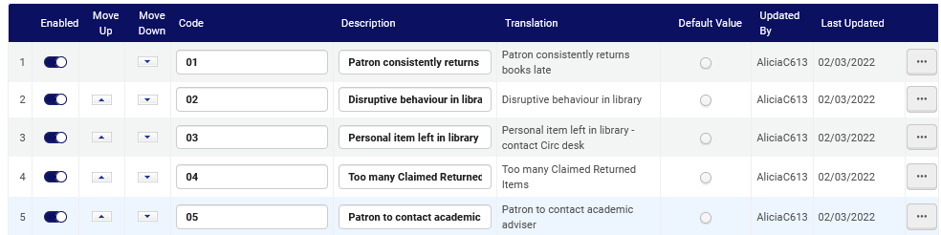
Testing the librarian-assigned blocks
In "User Block Descriptions" we have a block "Disruptive behavior in library".

Slide 20
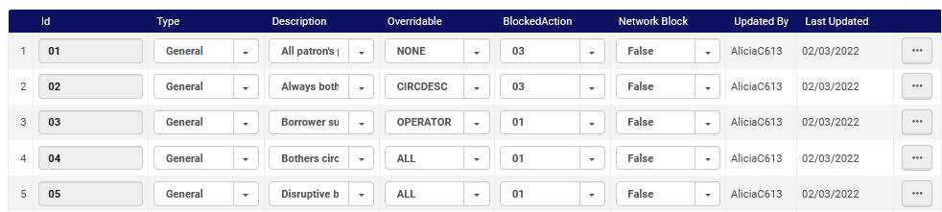
Testing the librarian-assigned blocks
In "User Block Definitions" we have stated that this block applies to "01 – loan" and all staff users can override it.

Slide 21
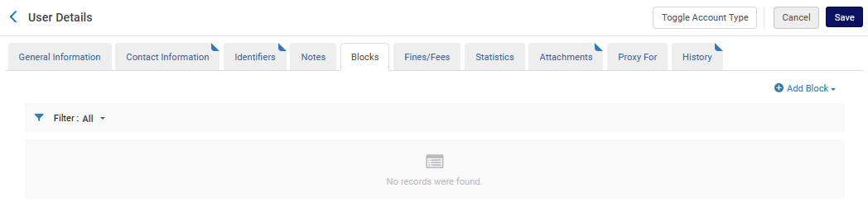
Testing the librarian-assigned blocks
We will add a librarian-assigned block for patron Anna Nemati:

Slide 22
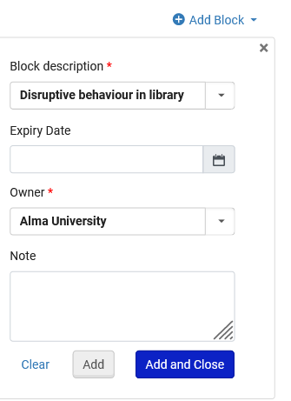
Testing the librarian-assigned blocks
We will add the block "Disruptive behavior in the library":

Slide 23
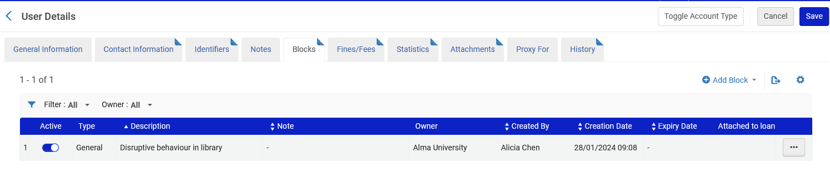
Testing the librarian-assigned blocks
Here is the block in the user details

Slide 24
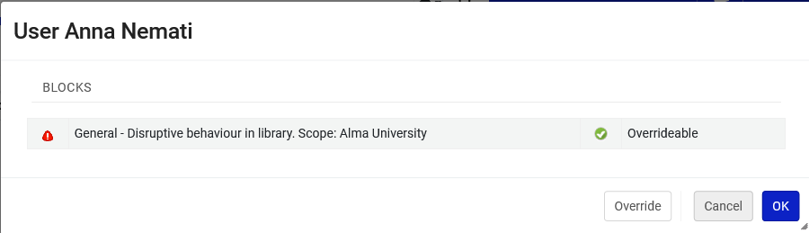
Testing the librarian-assigned blocks
If we try to loan an item to Anna, we correctly get this message:

Slide 25
System-assigned blocks

Slide 26
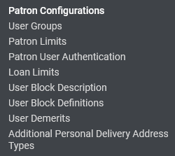
System-assigned blocks
As previously mentioned, the system-assigned blocks are also known as "limits" and the block occurs when the limit is surpassed.
These limits may be defined in the "Loan Limits" and "Patron Limits" tables, both accessible via the fulfillment configuration menu "Patron Configurations" section.

Slide 27
System-assigned Loan Limits

Slide 28
System-assigned Loan Limits
As previously mentioned, the system-assigned blocks are also known as "limits" and the block occurs when the limit is surpassed.
These limits may be defined in the "Loan Limits" and "Patron Limits" tables, both accessible via the fulfillment configuration menu "Patron Configurations" section.

Slide 29
System-assigned Loan Limits
The Loan Limits consist of rules based on various parameters.
On the next slide we have a rule which states that if the user group of the patron is "Undergraduate Student" then he or she can loan up to 2 items.

Slide 30
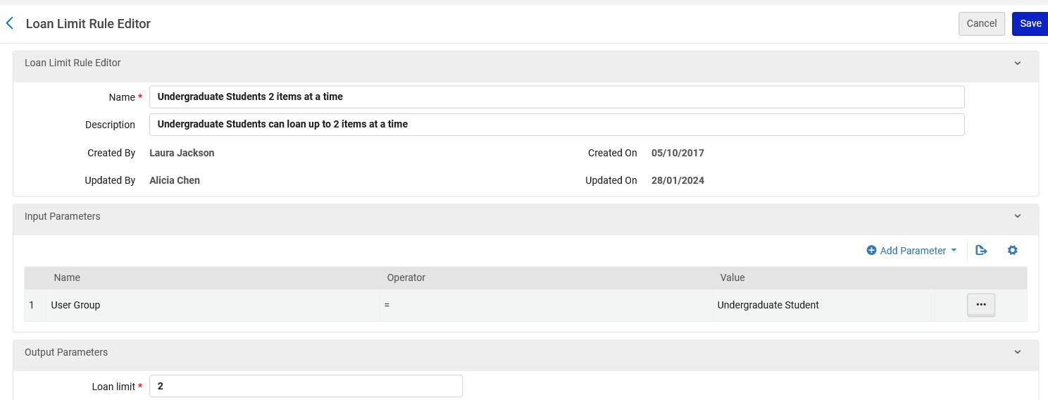
System-assigned Loan Limits

Slide 31
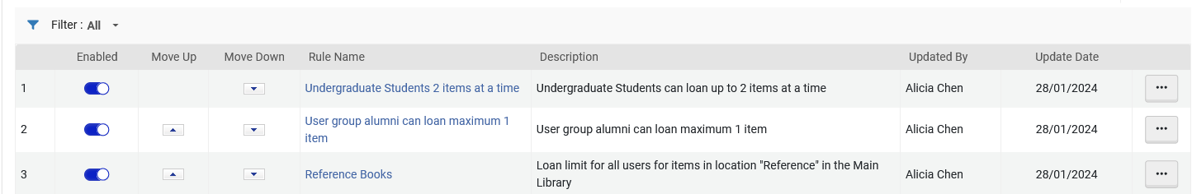
System-assigned Loan Limits
As in other places where rules are defined, each rule appears, and the order may be determined so that certain rules will take precedence over other rules (it is read top to bottom)

Slide 32
System-assigned Patron Limits

Slide 33
System-assigned Patron Limits
On the next slide we have defined a patron limit for user group "Undergraduate Student" as follows:
A maximum of:
10 units of currency in owed fines and fees
1 overdue item
1 booking request
1 overdue recalled item
3 digitization requests
3 physical item requests
After reaching any of these limits the patron will be blocked.

Slide 34
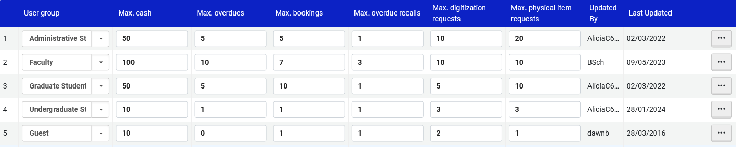
System-assigned Patron Limits

Slide 35
Testing System-assigned Loan & Patron Limits

Slide 36
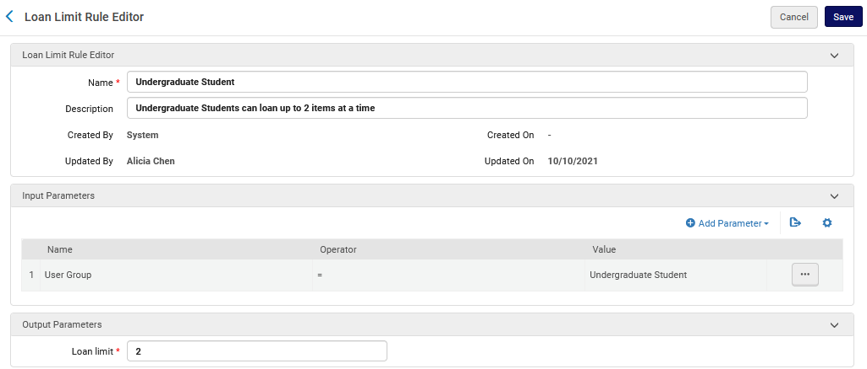
Testing System-assigned Loan & Patron Limits
We will now test this rule which we made a few moments ago in which a patron with user group “Undergraduate Student” can loan up to two items

Slide 37
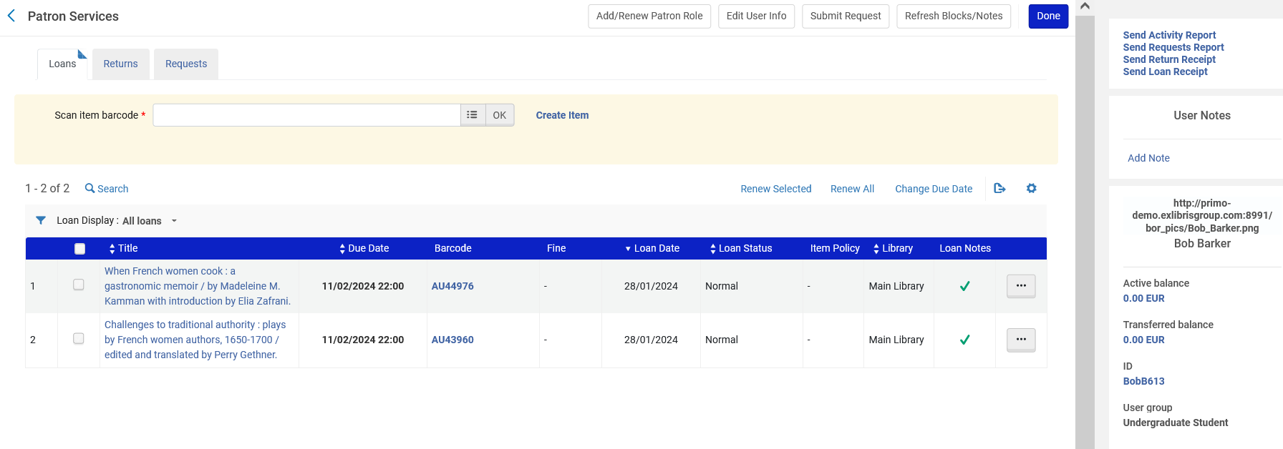
Testing System-assigned Loan & Patron Limits
User Bob Barker is an Undergraduate Student with two items on loan

Slide 38
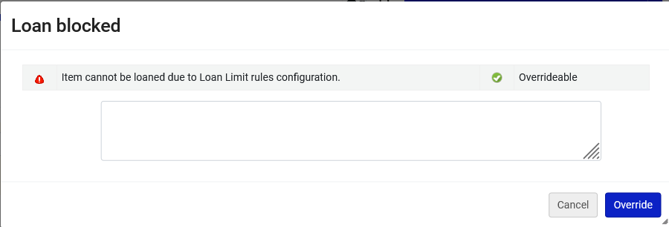
Testing System-assigned Loan & Patron Limits
If we try to loan another item to Bob Barker, then we get this message:

Slide 39
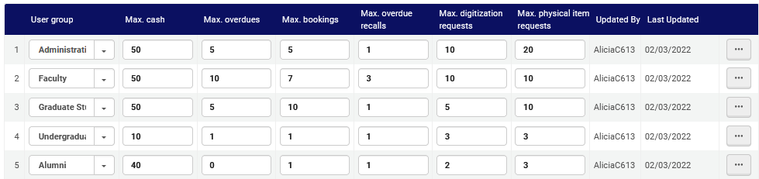
Testing System-assigned Loan & Patron Limits
We will now test this limit which we made a few moments ago
An undergraduate student can owe the institution up to 10 units of currency

Slide 40
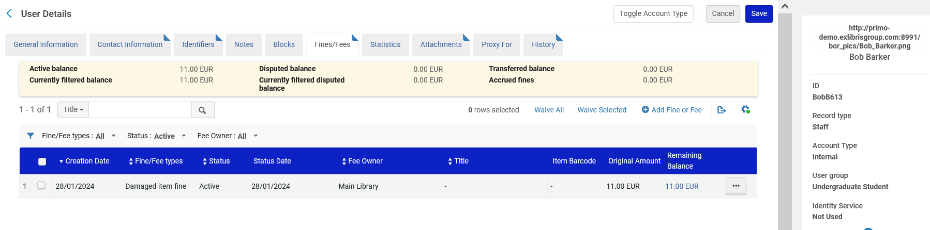
Testing System-assigned Loan & Patron Limits
User Bob Barker owes the library 11 Euro and is in user group Undergraduate student

Slide 41
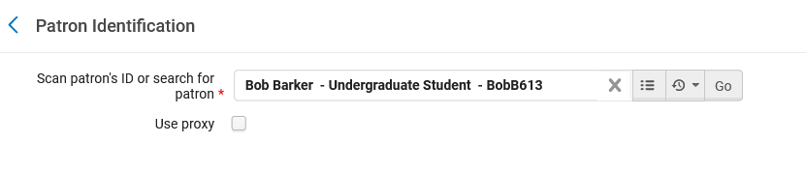
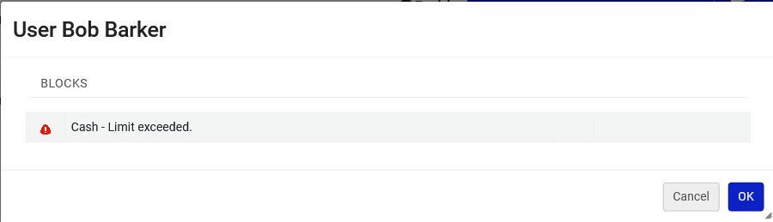
Testing System-assigned Loan & Patron Limits
If we try to loan something to Bob Barker, we see that he is blocked by the system.
The message is based on the patron limit we defined a moment ago in which there is a limit of 10 units of currency owed to the library.
There is no option to “override”. More on that later.

Slide 42
Overriding the system-assigned blocks

Slide 43
Overriding the system-assigned blocks
We did not have an option to override the block when the patron exceeded the cash limit
There is no option to “override”.

Slide 44
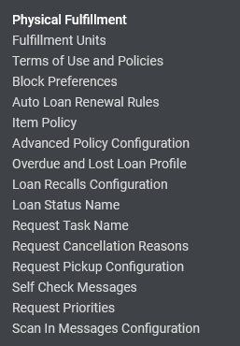
Overriding the system-assigned blocks
The ability to override these blocks is configured in the "Block Preferences" table accessible via the "Physical Fulfillment" section of the fulfillment configuration menu

Slide 45
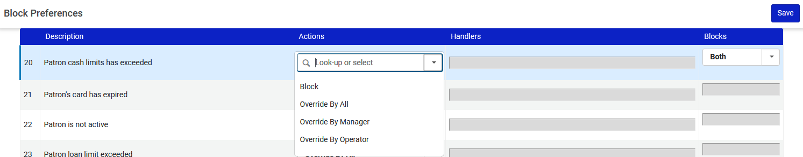
Overriding the system-assigned blocks
This is why we could not override the cash limit:
We change it to one of these options:

Slide 46
Overriding the system-assigned blocks
Here is an explanation of the options:
ALL – The block is overridable by any circulation desk operator
NONE – The block is not overridable
CIRCDESC – The block is overridable only by a circulation desk manager
OPERATOR – The block is overridable by a circulation desk manager or a circulation desk operator (and not a user with circulation desk operator – limited permissions)

Slide 47
Overriding the system-assigned blocks
Now we have changed it to “Override By All”

Slide 48
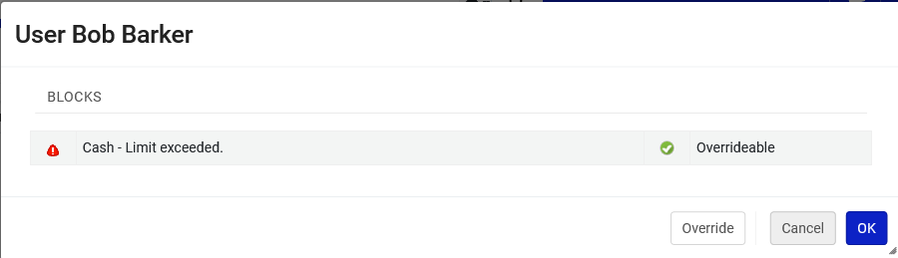
Overriding the system-assigned blocks
Now we do have the option to override when trying to loan to a patron with user group "Undergraduate Student" who has exceeded his or her allowed amount of cash limit.

